Slide 1
Generalized IPv6 Tunnel solution
Qiangzhou Gao

Slide 2
Why Need GIP6
Currently there are many types of IP tunnels, such as VXLAN and GRE. On IPv6 networks, it is hard to define extensions for all these tunnels to support new features. On the other hand it is not recommended to extend new features based on the IPv4 data plane for these tunnels
There have been many types of IP tunnels
New Features
GRE Tunnels: defined in [RFC2784].
IP in IP Tunnels: defined in [RFC1853].
L2TPv3 Tunnels: defined in [RFC3931].
ISATAP Tunnels: defined in [RFC4214].
IPv4/IPv6 over IPv6 (4over6) Tunnels: defined in [RFC2473].
VXLAN Tunnels: defined in [RFC7348].
NVGRE Tunnels: defined in [RFC7637].
MPLS over UDP: defined in [RFC7510].
VXLAN-GPE (Generic Protocol Extension for VXLAN) Tunnels: defined in [I-D.ietf-nvo3-vxlan-gpe].
[I-D.dong-6man-enhanced-vpn-vtn-id] defines the IPv6 encapsulation used to determine resource isolation.
[I-D.li-apn-ipv6-encap] defines the IPv6 encapsulation of an APN.
[I-D.ietf-6man-ipv6-alt-mark] defines IPv6 encapsulation for Alternate Marking.
[I-D.ietf-ippm-ioam-ipv6-options] defines IPv6 encapsulation for IOAM.

Slide 3
Challenges
If the existing IP tunnels need to support new features such as Alternate Marking, IOAM, resource isolation, and APN, the following problems exist:
A Lot Of Standardization work: All of the IP tunnels mentioned above need to be extended accordingly, resulting in a lot of standardization work.
It is hard to keep the consistency between IPv4 and IPv6 for these IP tunnels (except IPv4 transition tunnels) since the possible extensions are recommended to be only done over the IPv6.
Functions Redundant: IPv6 can directly support some functions of these IP tunnels which cannot be done over the IPv4. This means such functions becomes redundant over the IPv6. For example, VXLAN takes use of the UDP to support ECMP. However for the IPv6 VXLAN, the Flow Label in the IPv6 header can also be used to support ECMP.
Difficult to extend based on the existing format: Some IP tunnels such as VXLAN and GRE have their own headers. If these tunnels need to support new features over the IPv6, there will face the challenge of the choice between reusing the exiting IPv6 encapsulations for these new features based on the IPv6 extension header and define new extensions based on their own tunnel headers.
- If the tunnel header is extended, it will be redundant with the existing IPv6 encapsulation for the new features based on the IPv6 extension header.
- For some existing IP tunnels (such as IP in IP) that do not have their own headers, they have to reuse the IPv6 encapsulations for these new features based the IPv6 header. extensions need to be redefined in the IPv6 extension header. As a result, their extensions may be different from that of the IP tunnels which have their own headers.

Slide 4
GIP6 Technical Description
The Generalized IPv6 (GIP6) tunnel is defined to use the IPv6 header and IPv6 extension header to support both existing IP tunnels functions and new features.
A GIP6 encapsulated packet has the following format:
Option 1 (Recommended)
+ - - - - - - - - - - - - - - - - - - - - - - - - - - - - - - - - - - - +
| IPv6 Header |
+ - - - - - - - - - - - - - - - - - - - - - - - - - - - - - - - - - - - +
| IPv6 Extension Header |
| (Encapsulations of new features + |
| Encapsulations of functions of existing IP tunnels) |
+ - - - - - - - - - - - - - - - - - - - - - - - - - - - - - - - - - - - +
| Payload packet |
+ - - - - - - - - - - - - - - - - - - - - - - - - - - - - - - - - - - - +
Option 2
+ - - - - - - - - - - - - - - - - - - - - - - - - - - - - - - - - - - - +
| IPv6 Header |
+ - - - - - - - - - - - - - - - - - - - - - - - - - - - - - - - - - - - +
| IPv6 Extension Header |
| (Encapsulations of new features) |
| |
+ - - - - - - - - - - - - - - - - - - - - - - - - - - - - - - - - - - - +
| Existing IP Tunnel Headers |
+ - - - - - - - - - - - - - - - - - - - - - - - - - - - - - - - - - - - +
| Payload packet |
+ - - - - - - - - - - - - - - - - - - - - - - - - - - - - - - - - - - - +
GIP6 Encapsulation
GIP6 Encapsulation

Slide 5
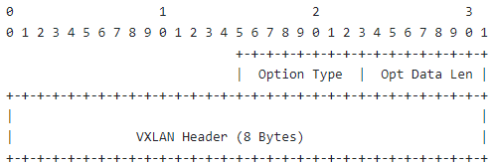
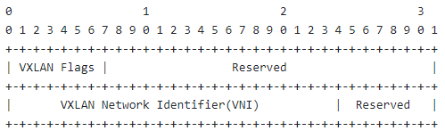
GIP6 for VXLAN
1. The function of the UDP is replaced by the flow label of the IPv6 header in the GIP6 tunnel. To ensure compatibility, the value of the flow label calculated for the purpose of ECMP SHOULD be the same as that of the source port of the UDP.
2. Definition of the VN Option
A new option called VN Option is defined to carry the VXLAN header information. The VN Option MUST only be encapsulated in the Destination Options Header (DOH).
VN Option
VXLAN headers

Slide 6
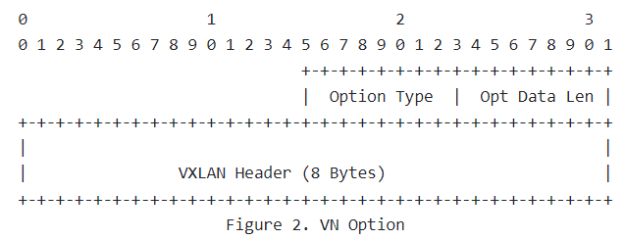
GIP6 for VxLAN: the encapsulation format of the data plane
GIP6 同样使得SRv6+VxLAN 成为一种新的创新方案，且更加灵活。
Option2：IPv6 Header + VXLAN6 Header
Option1：IPv6 Header Option
0 | 1 | 2 | 3
Outer Dest MAC Address
Outer Dest MAC Address |  | Outer Source MAC Address
Outer Source MAC Address
OptnlEthtype = C-Tag 802.1Q |  | Outer.VLAN Tag
Ethertype = 0x0800
Version | Traffic Class | Flow Label
Payload Length |  | NxtHdr=17(UDP) | Hop Limit
Outer Source IPv6 Address
Outer Dest IPv6 Address
Source Port |  | Dest Port = 4789
UDP Length |  | UDP Checksum
R|R|R|R|I|R|R|R | Reserved
VXLAN Network Identifier (VNI) |  |  | Reserved
Inner Dest MAC Address
Inner Dest MAC Address |  | Inner Source MAC Address
Inner Source MAC Address
OptnlEthtype = C-Tag 802.1Q |  | Outer.VLAN Tag
Ethertype = 0x0800
Payload
0 | 1 | 2 | 3
Outer Dest MAC Address
Outer Dest MAC Address |  | Outer Source MAC Address
Outer Source MAC Address
OptnlEthtype = C-Tag 802.1Q |  | Outer.VLAN Tag
Ethertype = 0x0800
Version | Traffic Class | Flow Label
Payload Length |  | NxtHdr=143(Eth) | Hop Limit
Outer Source IPv6 Address
Outer Dest IPv6 Address
DOH VN option
DOH VN option
Inner Dest MAC Address
Inner Dest MAC Address |  | Inner Source MAC Address
Inner Source MAC Address
OptnlEthtype = C-Tag 802.1Q |  | Outer.VLAN Tag
Ethertype = 0x0800
Payload
OutEth: 14B (+ 4B)
IPv6：40B
UDP：16B
VXLAN：16B
InnerEth: 14B (+ 4B)
Notes:
给V4升级V6的建议
切片： ipv6 扩展头定义了相关信息
隧道： MPLS 。。。。 没有IPv6头确实难以支持
GRE， VxLan
陈双龙(00419335)2022-10-28 10:22 疑惑点1. 既然IPv6头已经定义了 切片、apn、ioam等， 隧道直接用IPv6 头的这些信息就完了， 隧道为什么还要扩展定义一下呢？（单域和跨域 貌似都没有这种需求） 李振斌(00392056)2022-10-28 10:24 事实上不是这么简单，因为本来就有两种选择，可以直接在隧道头后面扩展，没有人规定这些IPv6信息可以直接用的。 李振斌(00392056)2022-10-28 10:25 而在隧道头上扩展是通用的实现方法，因为这样保证IPv4和IPv6一致。
Pv4 还需要支持切片吗， 李振斌(00392056)2022-10-28 10:26 支持啊。园区现在就是要支持切片，而且基本上所有园区都是IPv4的。 陈双龙(00419335)2022-10-28 10:36 问了董杰，确实vxlan头里 扩展支持了 切片 陈双龙(00419335)2022-10-28 10:37 澄清一个应用场景： 对于单栈 IPv4的网络 GIP6 是不是 没有用武之地。 只能作为 payload 穿越 陈双龙(00419335)2022-10-28 10:41 也就是说既然园区基本都是IPv4的， 我们GIP6 似乎也无法应用于 园区这种纯 IPv4的 网络场景。 您撤回了一条消息 陈双龙(00419335)2022-10-28 10:43 除非 GIP6 的信息，放到报文payload里，也传递到让园区IPv4设备上， 让这些设备支持再深入处理获得这些信息。 陈双龙(00419335)2022-10-28 10:44 或者： 推动 IPv4 网络 升级成 IPv6 网络

Slide 7
Comparison Between GIP6 and VXLAN
 | VXLAN | GPE/GENEVE | SRv6 | VXLAN6+ | GIP6
Number of supported users | Restricted | Restricted | It's big. | Restricted | It's big.
Scalability | poor | Good. | Good. | poor | Good.
Path Orchestration Capability | poor | poor | Good. | poor | Good.
Service orchestration capability | poor | poor | Good. | poor | Good.
Hardware Constraints | Higher | Higher | Low | Low | Low
Packet encapsulation efficiency | Lower | Medium | Gao | Gao | Gao
Requirements for network planning | Medium | Medium | Gao | Medium | Gao
Upgrade Compatibility | Stop the evolution. | Good. | Evolution based on IPv6 | Good. | Evolution based on IPv6
Notes:
给V4升级V6的建议
切片： ipv6 扩展头定义了相关信息
隧道： MPLS 。。。。 没有IPv6头确实难以支持
GRE， VxLan
陈双龙(00419335)2022-10-28 10:22 疑惑点1. 既然IPv6头已经定义了 切片、apn、ioam等， 隧道直接用IPv6 头的这些信息就完了， 隧道为什么还要扩展定义一下呢？（单域和跨域 貌似都没有这种需求） 李振斌(00392056)2022-10-28 10:24 事实上不是这么简单，因为本来就有两种选择，可以直接在隧道头后面扩展，没有人规定这些IPv6信息可以直接用的。 李振斌(00392056)2022-10-28 10:25 而在隧道头上扩展是通用的实现方法，因为这样保证IPv4和IPv6一致。
Pv4 还需要支持切片吗， 李振斌(00392056)2022-10-28 10:26 支持啊。园区现在就是要支持切片，而且基本上所有园区都是IPv4的。 陈双龙(00419335)2022-10-28 10:36 问了董杰，确实vxlan头里 扩展支持了 切片 陈双龙(00419335)2022-10-28 10:37 澄清一个应用场景： 对于单栈 IPv4的网络 GIP6 是不是 没有用武之地。 只能作为 payload 穿越 陈双龙(00419335)2022-10-28 10:41 也就是说既然园区基本都是IPv4的， 我们GIP6 似乎也无法应用于 园区这种纯 IPv4的 网络场景。 您撤回了一条消息 陈双龙(00419335)2022-10-28 10:43 除非 GIP6 的信息，放到报文payload里，也传递到让园区IPv4设备上， 让这些设备支持再深入处理获得这些信息。 陈双龙(00419335)2022-10-28 10:44 或者： 推动 IPv4 网络 升级成 IPv6 网络

Slide 8

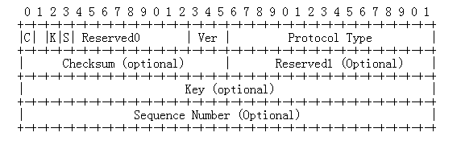
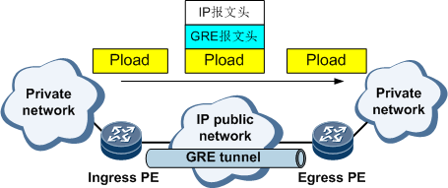
GIP6 For GRE
Application scenario: GRE encapsulates packets of one network layer protocol into packets of another network layer protocol for transmission. Tunnels are recommended in the SD-WAN solution and are usually used together with GRE over IPSec.
When the system receives the data of a certain network layer protocol that needs to be encapsulated and routed, it adds a GRE header to the data and encapsulates the data in another protocol, such as IP. In this way, the IP protocol is responsible for forwarding the packet.
Passenger protocol: The packet protocol before encapsulation is called passenger protocol.
Encapsulation Protocol (Encapsulation Protocol): The foregoing GRE protocol is called the encapsulation protocol, also called the carrier protocol (Carrier Protocol).
Transport protocol (Transport Protocol or Delivery Protocol): A protocol that forwards encapsulated packets is referred to as a transport protocol.
Restriction 1:
The Key field is short and has poor scalability.
Restriction 2:
The keepalive, mtu, and path mtu mechanisms are defined, which increases the complexity.
Restriction 3:
Extension of new features is not supported.
After receiving the private network packet from the interface connected to the private network, the ingress PE performs GRE tunnel encapsulation.
The egress PE receives the packet from the interface connected to the public network and analyzes the IP header. The egress PE finds that the destination address of the packet is the local device and the protocol field value is 47, indicating that the protocol is GRE (see RFC 2784). Then, the egress PE performs GRE decapsulation and removes the IP header and GRE header. Then, based on the Protocol Type field in the GRE header, the finds that the passenger protocol of the packet is IP. Then, the searches the routing table for the private IP address and forwards the packet.
Notes:
给V4升级V6的建议
切片： ipv6 扩展头定义了相关信息
隧道： MPLS 。。。。 没有IPv6头确实难以支持
GRE， VxLan
陈双龙(00419335)2022-10-28 10:22 疑惑点1. 既然IPv6头已经定义了 切片、apn、ioam等， 隧道直接用IPv6 头的这些信息就完了， 隧道为什么还要扩展定义一下呢？（单域和跨域 貌似都没有这种需求） 李振斌(00392056)2022-10-28 10:24 事实上不是这么简单，因为本来就有两种选择，可以直接在隧道头后面扩展，没有人规定这些IPv6信息可以直接用的。 李振斌(00392056)2022-10-28 10:25 而在隧道头上扩展是通用的实现方法，因为这样保证IPv4和IPv6一致。
Pv4 还需要支持切片吗， 李振斌(00392056)2022-10-28 10:26 支持啊。园区现在就是要支持切片，而且基本上所有园区都是IPv4的。 陈双龙(00419335)2022-10-28 10:36 问了董杰，确实vxlan头里 扩展支持了 切片 陈双龙(00419335)2022-10-28 10:37 澄清一个应用场景： 对于单栈 IPv4的网络 GIP6 是不是 没有用武之地。 只能作为 payload 穿越 陈双龙(00419335)2022-10-28 10:41 也就是说既然园区基本都是IPv4的， 我们GIP6 似乎也无法应用于 园区这种纯 IPv4的 网络场景。 您撤回了一条消息 陈双龙(00419335)2022-10-28 10:43 除非 GIP6 的信息，放到报文payload里，也传递到让园区IPv4设备上， 让这些设备支持再深入处理获得这些信息。 陈双龙(00419335)2022-10-28 10:44 或者： 推动 IPv4 网络 升级成 IPv6 网络

Slide 9

GIP6 for GRE： Simplifies Encapsulation on IPv6 Networks
POP HUB
传统网关
PE
云专网
PE
客户站点1
SD-WAN
SD-WAN
客户站点2
Internet
GRE over IPsec
GRE over IPsec
BGP-EVPN
BGP-EVPN
Encapsulation efficiency is improved by reducing GRE packet headers.
Encapsulation using Option1： The IPv6 packet header and Option field carry GRE control information.
0
7
15
23
31
IPv6 Header
GRE Header
Payload Packet
IPv6 Header
Payload Packet
Version
Traffic Class
Flow Label
Payload Length
Next Header
Hop Limit
Source Address
（IPv6 SA）
Destination Address
（IPv6 DA）
DOH/HBH
Option
Extension Header Data
Next Header
Extension Header Len
Extension Header Data
Next Header
Extension Header Len
…
Notes:
给V4升级V6的建议
切片： ipv6 扩展头定义了相关信息
隧道： MPLS 。。。。 没有IPv6头确实难以支持
GRE， VxLan
陈双龙(00419335)2022-10-28 10:22 疑惑点1. 既然IPv6头已经定义了 切片、apn、ioam等， 隧道直接用IPv6 头的这些信息就完了， 隧道为什么还要扩展定义一下呢？（单域和跨域 貌似都没有这种需求） 李振斌(00392056)2022-10-28 10:24 事实上不是这么简单，因为本来就有两种选择，可以直接在隧道头后面扩展，没有人规定这些IPv6信息可以直接用的。 李振斌(00392056)2022-10-28 10:25 而在隧道头上扩展是通用的实现方法，因为这样保证IPv4和IPv6一致。
Pv4 还需要支持切片吗， 李振斌(00392056)2022-10-28 10:26 支持啊。园区现在就是要支持切片，而且基本上所有园区都是IPv4的。 陈双龙(00419335)2022-10-28 10:36 问了董杰，确实vxlan头里 扩展支持了 切片 陈双龙(00419335)2022-10-28 10:37 澄清一个应用场景： 对于单栈 IPv4的网络 GIP6 是不是 没有用武之地。 只能作为 payload 穿越 陈双龙(00419335)2022-10-28 10:41 也就是说既然园区基本都是IPv4的， 我们GIP6 似乎也无法应用于 园区这种纯 IPv4的 网络场景。 您撤回了一条消息 陈双龙(00419335)2022-10-28 10:43 除非 GIP6 的信息，放到报文payload里，也传递到让园区IPv4设备上， 让这些设备支持再深入处理获得这些信息。 陈双龙(00419335)2022-10-28 10:44 或者： 推动 IPv4 网络 升级成 IPv6 网络

Slide 10
GIP6 and GRE Comparison
 | GRE | GIP6
Scalability | poor | Good.
Path Orchestration Capability | poor | Good.
Service orchestration capability | poor | Good.
Hardware Constraints | Low | Low
Packet encapsulation efficiency | Medium | Medium
Requirements for network planning | Medium | Low
Upgrade Compatibility | Stop the evolution. | Good.
Notes:
给V4升级V6的建议
切片： ipv6 扩展头定义了相关信息
隧道： MPLS 。。。。 没有IPv6头确实难以支持
GRE， VxLan
陈双龙(00419335)2022-10-28 10:22 疑惑点1. 既然IPv6头已经定义了 切片、apn、ioam等， 隧道直接用IPv6 头的这些信息就完了， 隧道为什么还要扩展定义一下呢？（单域和跨域 貌似都没有这种需求） 李振斌(00392056)2022-10-28 10:24 事实上不是这么简单，因为本来就有两种选择，可以直接在隧道头后面扩展，没有人规定这些IPv6信息可以直接用的。 李振斌(00392056)2022-10-28 10:25 而在隧道头上扩展是通用的实现方法，因为这样保证IPv4和IPv6一致。
Pv4 还需要支持切片吗， 李振斌(00392056)2022-10-28 10:26 支持啊。园区现在就是要支持切片，而且基本上所有园区都是IPv4的。 陈双龙(00419335)2022-10-28 10:36 问了董杰，确实vxlan头里 扩展支持了 切片 陈双龙(00419335)2022-10-28 10:37 澄清一个应用场景： 对于单栈 IPv4的网络 GIP6 是不是 没有用武之地。 只能作为 payload 穿越 陈双龙(00419335)2022-10-28 10:41 也就是说既然园区基本都是IPv4的， 我们GIP6 似乎也无法应用于 园区这种纯 IPv4的 网络场景。 您撤回了一条消息 陈双龙(00419335)2022-10-28 10:43 除非 GIP6 的信息，放到报文payload里，也传递到让园区IPv4设备上， 让这些设备支持再深入处理获得这些信息。 陈双龙(00419335)2022-10-28 10:44 或者： 推动 IPv4 网络 升级成 IPv6 网络

Slide 11
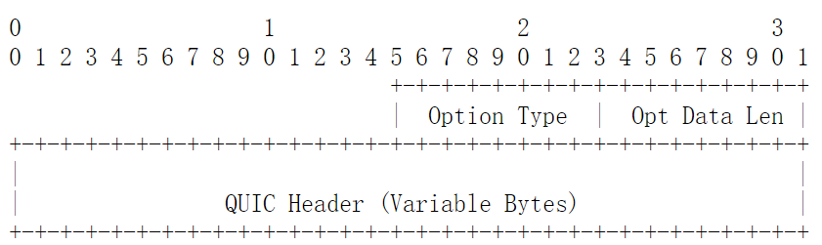
GIP6 for QUIC @ draft-li-rtgwg-gip6-for-quic-00
1. The function of the UDP is replaced by the flow label of the IPv6 header in the GIP6 tunnel. To ensure compatibility, the value of the flow label calculated for the purpose of ECMP SHOULD be the same as that of the source port of the UDP.
2. Definition of the QUIC Option
A new option called QUIC Option is defined to carry the VXLAN header information. The QUIC Option MUST only be encapsulated in the Destination Options Header (DOH).
QUIC Option

Slide 12
Technical Challenges to MPLS
MPLS is lack of the source indication and MP2P connections may occur. This causes the difficulty and complex process for OAM over MPLS. Although SFL( [RFC8957]) is defined, there is few implementation.
The payload type (for example, L2 or L3 packets) cannot be directly determined because there is no payload indication.
There is no metadata extensibility and it is difficult to encapsulate new forwarding attributes for the new features such as IETF network slicing, IFIT, and APN.
The process of the ECMP function is complex and affects forwarding performance. Entropy labels or flow labels are placed at the bottom of the label stack for processing and the internal IP header information may have to be parsed for the purpose of ECMP.
MPLS Label Encap
Label
TC
S
TTL
20
bits
3
bits
1
bit
8
bit

Slide 13
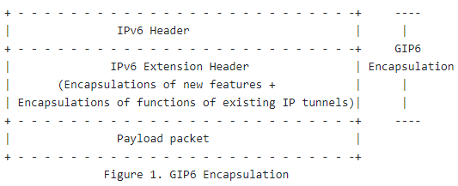
GIP6 tunnel for MPLS
Draft-li-rtgwg-generalized-ipv6-tunnel defines the GIP6 tunnel to support both new features(iOAM/APN…) and the existing functions for the IP tunnels based on the extension of the IPv6 extension header.
If the GIP6 tunnel is used for MPLS, there can be the following advantages:
1. The IPv6 source address is used to form a source identifier.
2. The IPv6 NH can indicate the payload type.
3. IPv6 flow labels are used to implement ECMP.
4. The encapsulations for the new features have been defined well in the IPv6 and can be reused easily.

Slide 14
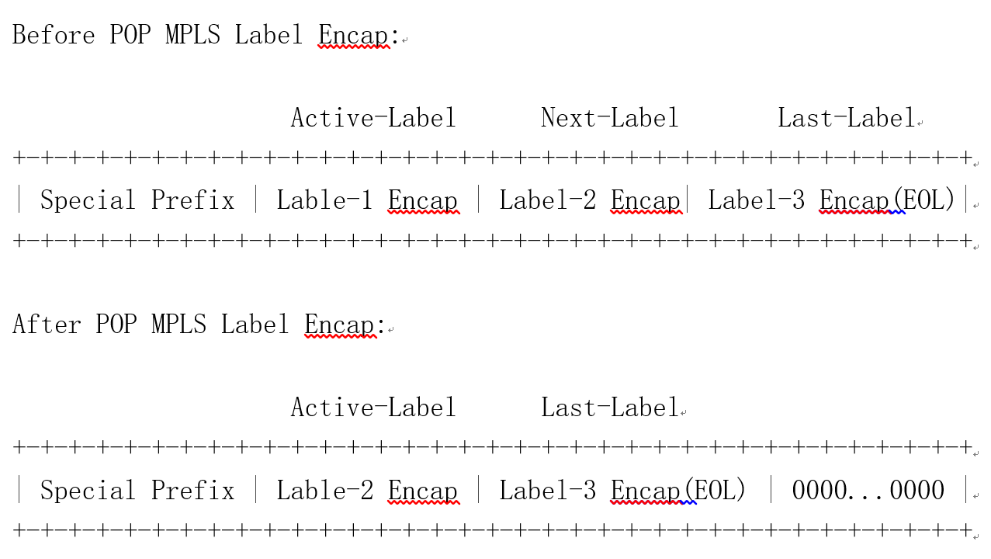
IPv6 MPLS SID(Type 1) can be placed in the IPv6 destination address
Processing of the first label following the special prefix is as follows:
(1) If the local action of the MPLS label is POP, the followed label encapsulations are shifted left by 32 bits after the label is popped. The following figure shows the process.
(2) If the local action of the MPLS label is SWAP, the label encapsulation is changed to the new label after swap.

Slide 15
IPv6 MPLS SID(Type 2) can be placed in the IPv6 RH
If all the MPLS label stack cannot be placed in the IPv6 destination address, IPv6 RH can be used to house the remaining MPLS label stack.
(1) IPv6 MPLS SID (Type 2) is defined to house multiple (<= 4) label encapsulations. The format of the IPv6 MPLS SID (Type 2) is shown in the following figure.
0 1 2 3
0 1 2 3 4 5 6 7 8 9 0 1 2 3 4 5 6 7 8 9 0 1 2 3 4 5 6 7 8 9 0 1
+-+-+-+-+-+-+-+-+-+-+-+-+-+-+-+-+-+-+-+-+-+-+-+-+-+-+-+-+
| MPLS Label Encap (4 octets) |
+-+-+-+-+-+-+-+-+-+-+-+-+-+-+-+-+-+-+-+-+-+-+-+-+-+-+-+-+
| MPLS Label Encap (4 octets) |
+-+-+-+-+-+-+-+-+-+-+-+-+-+-+-+-+-+-+-+-+-+-+-+-+-+-+-+-+
| MPLS Label Encap (4 octets) |
+-+-+-+-+-+-+-+-+-+-+-+-+-+-+-+-+-+-+-+-+-+-+-+-+-+-+-+-+
| MPLS Label Encap (4 octets) |
+-+-+-+-+-+-+-+-+-+-+-+-+-+-+-+-+-+-+-+-+-+-+-+-+-+-+-+-+
(2) IPv6 MPLS SID (Type 2) is used as the segment in the RH. After all of the label encapsulations in the IPv6 destination address are popped, the first label encapsulation in the segment indicated by the SL of the RH will be processed.

Slide 16
Thank You

